Slide 1
COMP1003 – Algorithms, Data Structures & Maths Session - 0 Technicalities
Thomas Wennekers
University of Plymouth

Slide 2
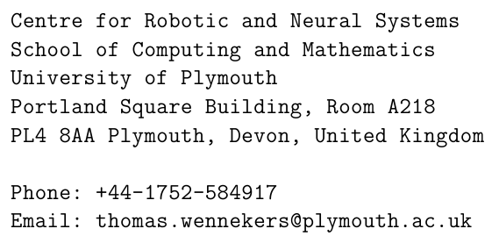
Contact Details
Dr Thomas Wennekers
(Reader in Computational Neuroscience)
Contact: by email
Room A316

Slide 3
Contact and Surgery Hours
Ask content questions in the Sessions
Content questions by email may be put forward to the next session
I tend to give vague answers to make students find their own
Surgery Hours (shared with other modules&topics)
See Module Webpage
https://dle.plymouth.ac.uk/course/view.php?id=60190

Slide 4
Structure
Two equally important halves
Mathematics
First 6 weeks
Some basic topics, some advanced
You may want paper and pencil close by
Algorithms and Data Structures
Second 6 weeks
You need access to C# / Visual Studio / Mono

Slide 5
Delivery
2*12 weekly 2 hour seminar sessions
Face2face only
Panopto Recordings
Mix of lectures and some exercises in sessions
Focus on specific topics per session
Some weekly exercises with solutions the week after
Relatively low dependencies between topics

Slide 6
Self Guided Studies
20 credit module == 200 hours work
~50h sessions
150h self-guided study
Do the unmarked exercises –> formative feedback
Read Books / Tutorials / Youtube
Coursework

Slide 7
Books?
Neither Maths nor A&D are taught by a specific book
Easy to find free books/tutorials online
Session material should suffice to pass the assessments

Slide 8
Assessment
Assessment is 100% by coursework – NO Exam
30%: Set Exercises -- Maths only
70% Programming Exercise -- A&DS only
Referral will be, both, Maths and Algorithms !

Slide 9
Assessment Hand-in Dates
Release: Probably this week
Set Exercises: 20 March 2023, 4:00pm
“Report”/CW: 18 May 2023, 4:00pm

Slide 10
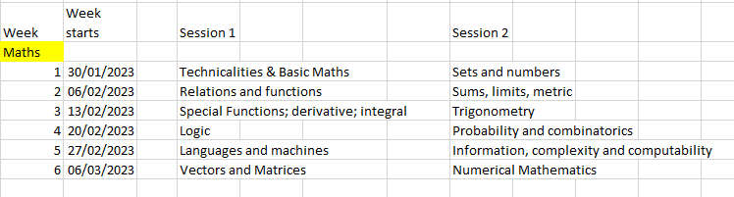
Contents: Maths (subject to change)
Assessed by set exercises
Specs to come (probably) next week.

Slide 11
Maths Crib Sheet
https://dle.plymouth.ac.uk/mod/resource/view.php?id=1476226
This contains much of what we will do in the first 6 weeks

Slide 12
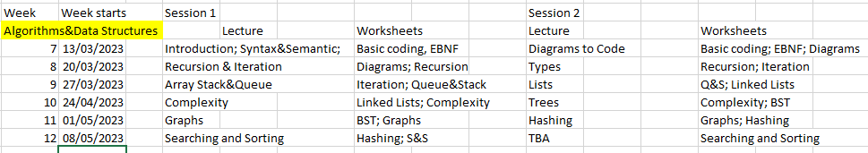
Contents: A&DS
Assessed by programming exercise
Specs to come probably this or next week.

Slide 13
Calculators
You don’t need one for this module

Slide 14
Weekly Exercises
https://dle.plymouth.ac.uk/course/view.php?id=60190

Slide 15
Coding in the 2nd Half (Algorithms and Data Structures)
We expect you can write basic C# code by then
“basic” = arithmetic & logical expressions, conditionals, loops, File I/O, methods
You will not use more advanced C# constructs
… especially not the Collections class
We will code our own data structures

Slide 16
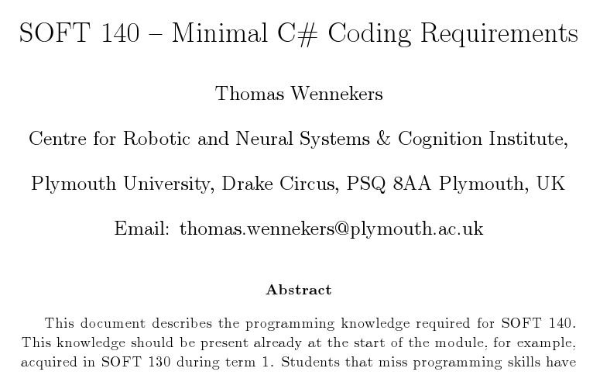
Algorithms Part: C# Primer
The primer is on the DLE pages

Slide 17
The C-Core of C#
What’s in the Primer *is* what I call
the C-Core of C#

Slide 18
More Information
Email/Announcements (check !!)
Portal Pages/DLE
https://dle.plymouth.ac.uk/course/view.php?id=53512
general info
Session schedule
Assignments; specs and submission
Lecture recordings (Panopto)

Slide 19
Questions?

